Slide 1
Word Press KIA Solution

Slide 2
Agenda
Overview of Wordpress Implementation
Oracle Right-Now Process – Before Migration
WordPress Process – After Migration
Oracle Right-Now to WordPress Articles Migration Process
WordPress Plugins Used
Questions by Matsuzaka, Hideaki
Appendix
Screen-Shots

Slide 3
Overview
Key advantages of Word Press KIA Solution:
User friendly: User can easily add/edit/delete/preview new articles from WordPress backend before article is published.
Multisite/ Multilingual: Multiple websites can be created within same WordPress setup. It also support multi lingual support to create website based on there region and there supportive language.
Open Source and Large Plugin Community: WordPress have large number of community plugin which are freely available and easy to use and configurable.
Theming: Full control for the frontend design where logos, colors, menus and navigation sidebars can be changes from backend easily.
Easy to upgrade and deploy

Slide 4
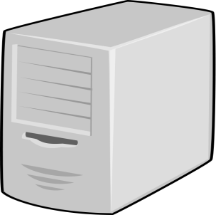

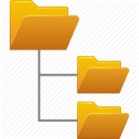




Oracle Right-Now Process – Before Migration
create articles
create/update articles
Oracle Right Now
pull articles
Agent
JAVA Program
distributed based on product and category
index articles
AUS
CHN
SG
TW
search content
article
URL
search content
Apache Tomcat
download article content
article URL

Slide 5



WordPress Process – After Migration
Application
create/update articles based on
product and category
post articles
create articles
Agent
Web Server
tag articles
search keyword translation
Translation API
Search Engine
index articles
Tagged Content
Repository
Translated text
search content
article
URL
User
search content
download article content
article URL
Application Server

Slide 6
Oracle Right-Now to WordPress Articles Migration Process
backup articles
pull articles based on product and category
Oracle Right Now
JAVA Application
AUS
distributed based on product and category
post articles
CHN
AUS
CHN
SG
TW
SG
TW
Apache

Slide 7
WordPress Plugins Used
Following are the list of Plugins used in Right-Now migration:
CCTM (Custom Content Type Manager): Used to create content category and analysis of contact section on the basis of content type.
Role Management: Create new roles for users and restrict them to access different modules.
File Manager: Used to make changes in WordPress file without using FileZilla or ftp from backend.
Ticket Support: Used for intercommunication of task allocation between all agents.
Error Log Monitor: Used to get email alert with error description
Import/Export Users: To import/export data in CVS format
WP Backup: To Backup code and DB

Slide 8
Questions by Matsuzaka, Hideaki
Active directory integration for user/group management
Current Implementation – Its not integrated with Active Directory
Suggestions : Asurion uses PingFederate for Signle Sign On. Wordpress supports many plugins which can be used for single sign on using PingFederate
Workflow management for contents approval
Current Implementation – Its been implemented using Wordpress Default Features
Light wait and fast searching with Japanese friendly syntax analyzer
Current Implementation – Wordpress is used to manage content. For searching, content is exported as HTML and indexed using SOLR (Lucent Search Engine).
Suggestions : We can either use SOLR or leverage AWS – Elastic Search Engine
How to monitor system health and performance
Current Implementation: LogMonitor Plugin
How to gather query statistics
Current Implementation: Custom implementation using Database Logging, and Dashboard to view query statistics

Slide 9
Appendix

Slide 10
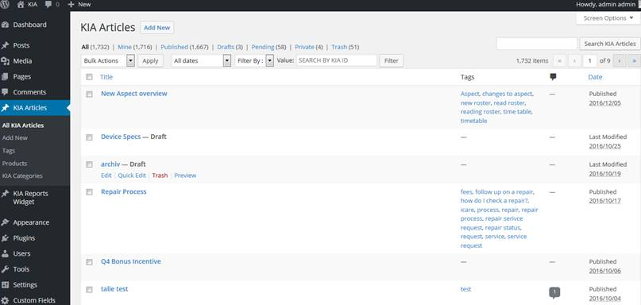
Screens
Word-Press Admin screen to create articles

Slide 11
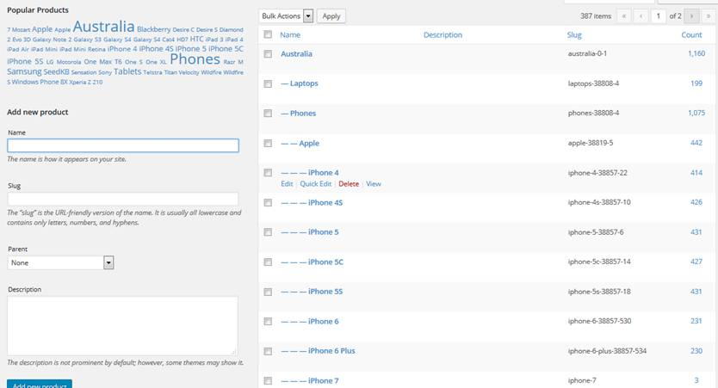
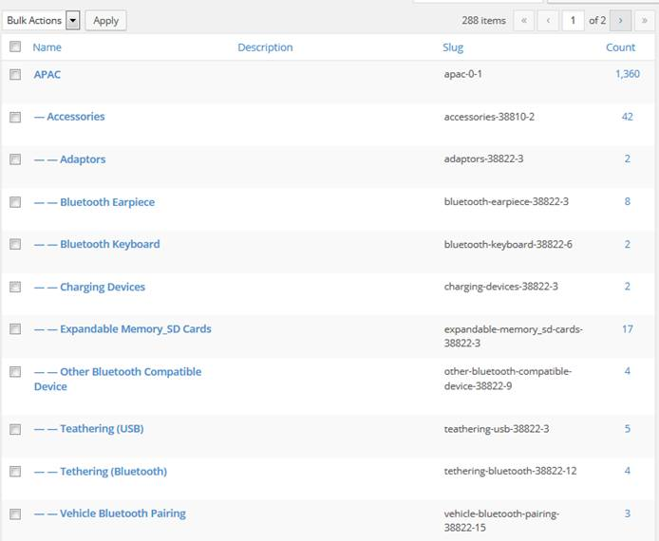
Screens
Product
Category

Slide 12
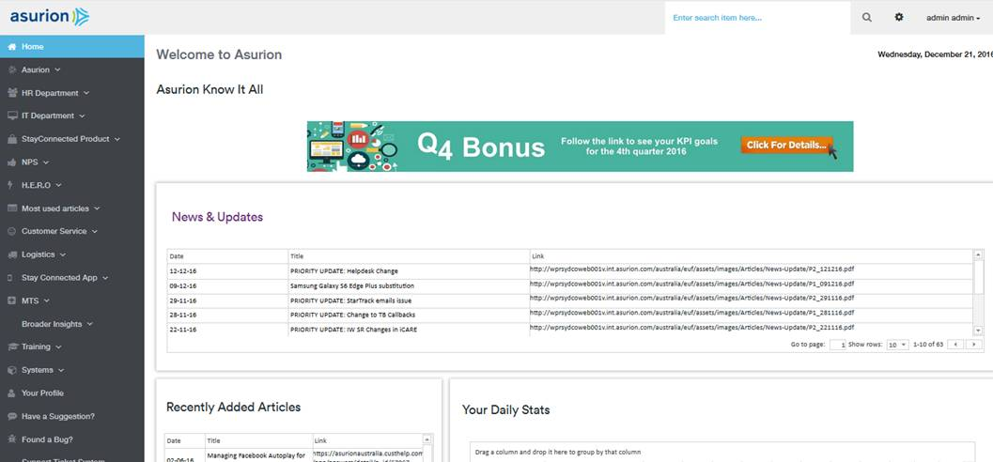
Screens
Agent Dashboard

Slide 13
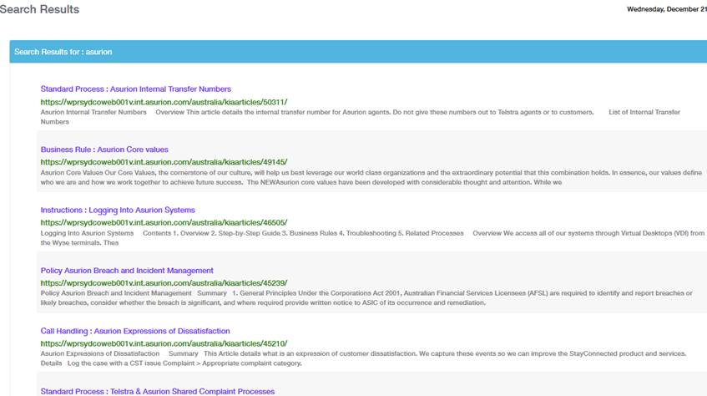
Screens
Article Search Result

Slide 14
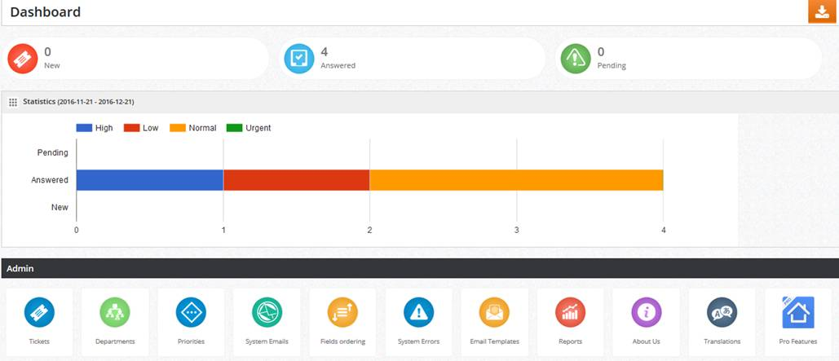
Screens
Ticket Support Dashboard

Slide 15
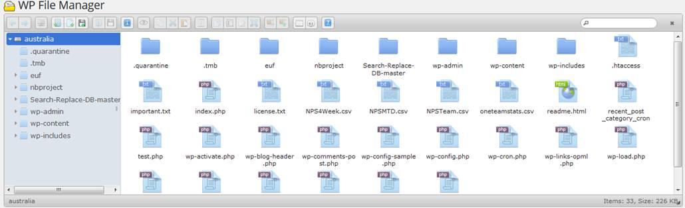
Screens
View/Modify Existing pages and media

